Slide 1
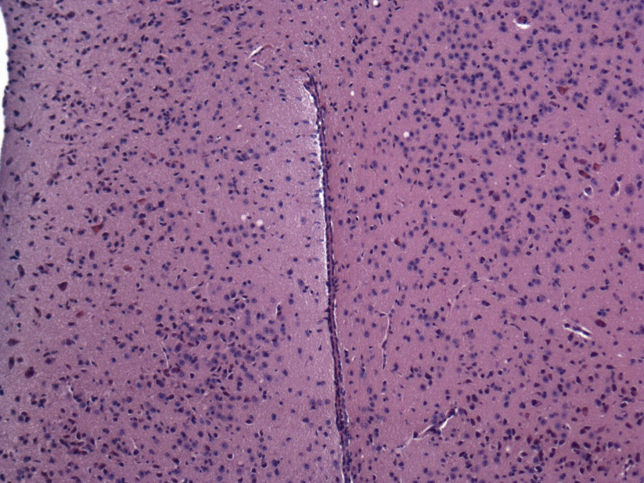
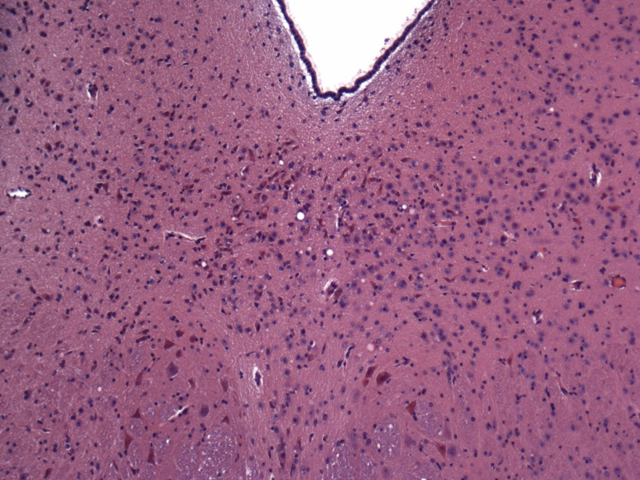
Appendix 8A: low grade vacuolation from 976A-1S mouse 5
Hypothalamus
Below level of aqueduct

Slide 2
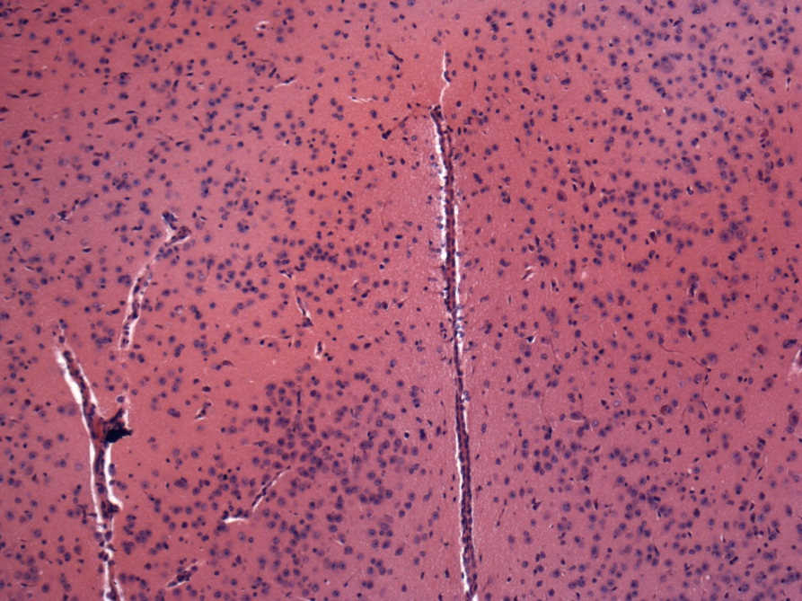
Appendix 9B: Example of negative vacuolation in tg 338 mouse brain.
Hypothalamus

