Slide 1
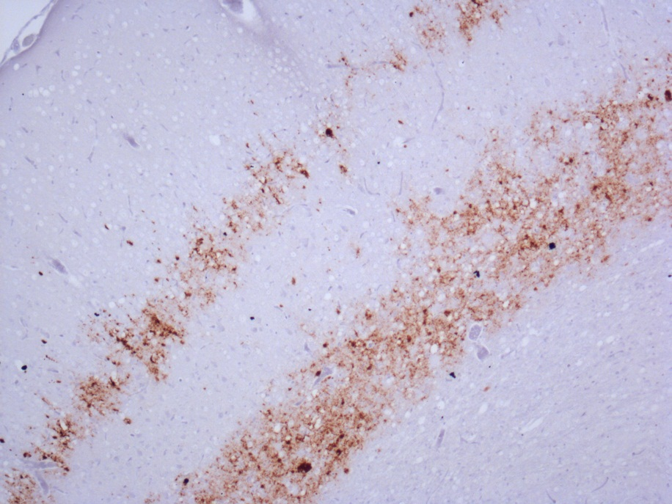
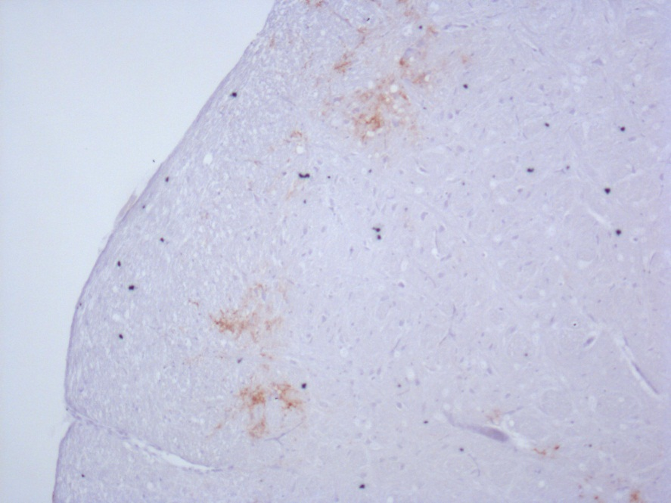
Appendix 9: Immunohistochemistry using BG4 in tg 338 mice clinically affected with atypical scrapie or natural scrapie.
Atypical scrapie
Natural scrapie
Brain area is cerebellum, antibody is BG4 and magnification is X10.

