Slide 1
Eating Well Choosing Better Programme Northern Ireland Tracking Research Produced for the FSA by 2CV Research
May 2019: Wave 4

Slide 2
Background & Objectives
Background
The FSA proposal for dietary health in Northern Ireland is to:
Align & collaborate with PHE on food product improvement and the joint ambition to remove 20% of sugar from foods typically consumed by children in NI by 2020
To lead on food product improvement with small/medium sized enterprises (SMEs)
To set the direction for the Eating Well Choosing Better Programme in NI at departmental level and lead key stakeholders to deliver on the outcomes
To empower, educate & inform consumers to make healthier choices the easier choices through a planned programme of intervention
The approach for the Eating Well Choosing Better Programme will be in line with the three identified PHE priorities for sugar reduction (reduction in sugar content per 100g of product, reduction in portion size, shift in product portfolio towards lower sugar varieties). Communications supporting this commenced in Feb-March 2018 and Jan-March 2019
Objectives of the tracking project
To measure success of the FSA Eating Well Choosing Better Programme through robust consumer insights and monitor how these change over time with manufacturing and campaign impact:
Understanding/knowledge of daily recommended calorie in take
Are consumers in favour of manufacturers reducing sugar and / or saturated fat and / or salt content of foods?
Do consumers look at front of pack traffic light labels?
Do consumers look for sugar on packaged food labels?
Do they look for calories on packaged food labels?
Does this influence consumers’ choice? If so how?
Do consumers look for / would they like to see /have they used calories on menus when eating out?
Would they like to see High Fat Sugar Salt snacks having a maximum number of calories?
Note: Key KPIs are shown in slides in this report but full data tables and sub-groups are provided in excel

Slide 3
Our Approach
Timings
Wave 1: November 2017 (Pre-campaign, February 2018 campaign launches)
Wave 2: May 2018 (Post-campaign)
Wave 3: November 2018
Wave 4: May 2019
Wave 5: November 2019
Wave 6: May 2020
Wave 7: November 2020
Wave 8: May 2021
Wave 9: November 2021
Wave 10: May 2022
Wave 11: November 2022
2CV/Community Research carried out a 10 minute online survey to measure success of the FSA food product improvement through robust consumer insights and monitor how these change over time with manufacturing and campaign impact.
A 4-5 year project, with consumer insights gathered twice a year.
A nationally representative sample of c.300 people per wave in Northern Ireland.
Nationally representative quotas set in terms of gender, age and SEG.

Slide 4
Whilst understanding of what is ‘healthier’ remains stable, seeking healthier options sees a directional decrease compared to this time last year
Healthy eating understanding and behaviour
Scale 1-10
10 =
strongly agree
1 =
strongly disagree
Demographics differences
(Wave 4)
Understand what is ‘healthier’
(7-10 on 10 pt. scale)
Significantly higher among
ABC1s
Actively seek out healthier options when shopping
(7-10 on 10 pt. scale)
Significantly lower amongst 16-34s vs other ages
Actively seek out healthier options when eating out
(7-10 on 10 pt. scale)
Significantly lower amongst
16-34s vs other ages
Consumers claim to understand what is healthier, but fewer are actively seeking out these healthier options when shopping/eating out, suggesting there is a role for making these healthier options more appealing rather than re-educating
Significant increase/ decrease versus previous wave
Source: 2CV Northern Ireland Tracking Project, Wave 4 May 2019.
K3: How much do you agree or disagree with the following statements (10 pt. scale).
Base: Nat Rep W1 (n=311), W2 (n=307), W3 (n=310), W4 (n=312)

Slide 5
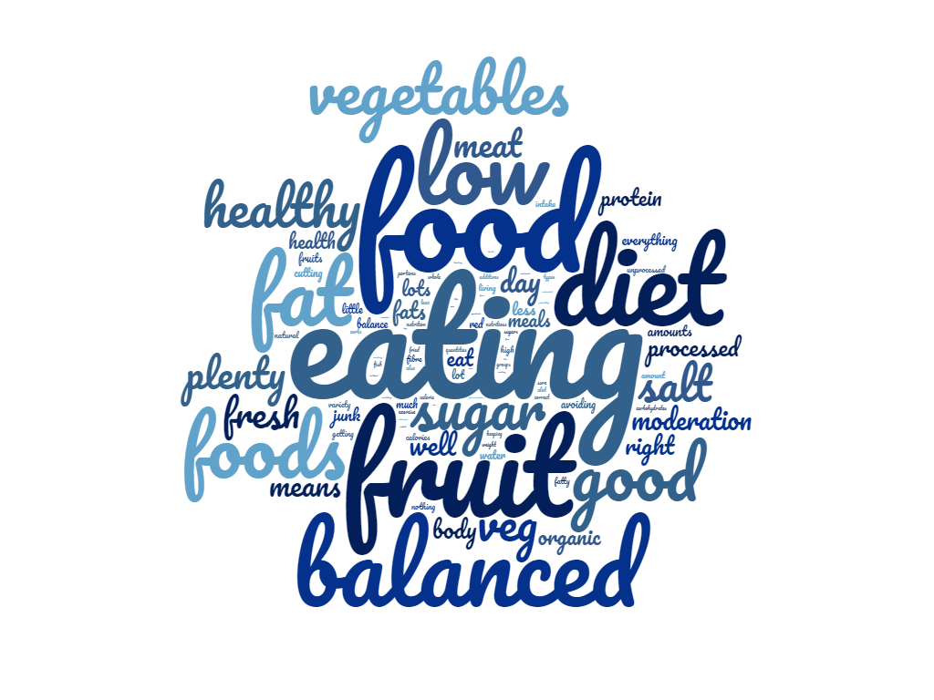
Calories are not top of mind when thinking about healthy eating: concerns are primarily around a balanced diet, with plenty of veg (and increasingly, less meat)
Spontaneous perceptions of healthy eating (May 2019)
What does healthy eating mean to you?
A balanced diet
“A balanced diet of meat and 5 veg”
“Consume a good cross section of foods required for healthy living”
Avoiding high sugar/fat foods
“Eating foods that are good for me, less sugars, salt and carbohydrates.”
“Eating good food which is low in fat, low in sugar, and low in salt, also eating fresh vegetables and fruit daily”
Focus on vegetables
“Lots of fruit and vegetables, not too much meat, full fat milk, butter and simple meals”
“Moderation, fruit and vegetables less meat portion control lots of water”
“Plant based whole foods”
A balanced diet with concerns over certain macronutrients remains top of mind rather than calories
Source: 2CV Northern Ireland Tracking Project, Wave 4 May 2019.
K1: What does healthy eating mean to you? (Spontaneous)
Base: Nat Rep W4 (n=312)

Slide 6
Understanding of traffic light labelling sees an increase in this wave, after remaining stable during 2017-18
Spontaneous (no image shown) knowledge of traffic light labels
Understanding (7-10 of 10pt scale) of traffic light labels
Most understand that the traffic lights are intended to help guide food choice, but specific understanding is mixed
Respondent quotes
Indicators of healthiness
“A quick guide to say how healthy the item is for you. Green is okay, red is not good and should be used in moderation”
“If traffic light is green then the ingredients in it is within the government guidelines, but if it is red then the ingredients is well out of your recommended daily allowance”
Indicators of fat, salt and sugar levels
“To let you know how much sugar or salt or fat is in the food”
“How much fat carbs etc is in food”
“How many calories sugar etc compared to daily recommendation”
Some lack of clarity:
“How unhealthy a food may be with red indicating an increased risk in physical health problems if regularly consumed”
“Good average and bad readings for the chemicals they put into food”
“Warnings of elements which, if exceeded on a frequent basis, can damage your health”
With continued exposure to the traffic light labelling understanding is gradually trending up but still remains an opportunity to educate about the specific meanings of the image
Source: 2CV Northern Ireland Tracking Project, Wave 4 May 2019.
B2: Overall how well do you understand what the traffic lights on the front of packaging are for? B1. What do you think these traffic lights are for? Base: Nat Rep W1 (n=311), W2 (n=307) w3 (n=310) W4 (n=312)
Significant increase/ decrease versus previous wave

Slide 7
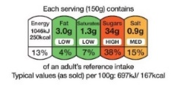
Encouragingly, both recognition and use of the traffic light labels continues to trend upwards
Prompted awareness (image shown) and usage of traffic light labels
Traffic light labels
Recognition and usage of traffic light labels
Although consumers increasingly claim to purchase products with healthier traffic light colours, the lower calorie products haven’t seen the same increase, suggesting there is an opportunity to link the two in consumers minds
Source: 2CV Northern Ireland Tracking Project, Wave 4 May 2019.
B2: Overall how well do you understand what the traffic lights on the front of packaging are for? B0: Do you recognise this traffic light image? B0a Do you use this when shopping for food? B4: Which of these best describes how often you buy these products? Base: Nat Rep W1 (n=311), W2 (n=307) w3 (n=310), W4 (n=312)
Significant increase/ decrease versus previous wave

Slide 8
As with previous waves, sugar remains the most consulted nutrient of traffic light labelling and sees a directional increase in this wave
Shopping behaviour around healthy eating
I look at the traffic light labels for…
(For myself)
Consultation of the traffic light labelling for calories, fat, saturates and salt remains notably behind sugar. There is an opportunity here to educate around the importance of calories and the other nutrients
Source: 2CV Northern Ireland Tracking Project, Wave 4 May 2019. B5a: Which of these do you do when buying food for yourself? B5b: Which of these do you do when buying food for your children? B5c: Which of these do you do when buying food for your grandchildren? Base: Nat Rep W1 (311), W2 (307), W3 (310); those with children W1 (99), W2 (114), W3 (110); those with grandchildren W1 (53), W2 (46), W3 (42)
Significant increase/ decrease versus previous wave

Slide 9
Sugar and Salt are key nutrients both parents and grandparents consult when looking at traffic light labels
Shopping behaviour around healthy eating
I look at the traffic light labels for…
Caution: Low base for grandparents (n=62 W4, c45/ wave)
(For my children)
(For my grandchildren)
Source: 2CV Northern Ireland Tracking Project, Wave 4 May 2019. B5a: Which of these do you do when buying food for yourself? B5b: Which of these do you do when buying food for your children? B5c: Which of these do you do when buying food for your grandchildren? Base: Nat Rep W1 (311), W2 (307), W3 (310); those with children W1 (99), W2 (114), W3 (110), W4 (89); those with grandchildren W1 (53), W2 (46), W3 (42), W4 (62)
Significant increase/ decrease versus previous wave

Slide 10
Understanding of recommended calorie intake sees a significant increase amongst men but remains stable amongst women
Understanding of calorie intake by gender
Women
Men
Despite this strong increase in knowledge of the correct calorie RDA amongst men, women remain much more likely to know their recommended intake and so there is an opportunity to increase targeting towards men
Source: 2CV Northern Ireland Tracking Project, Wave 4 May 2019.
K5: What do you think is the government recommended daily average allowance of calories? Please think what this is for women and men. Mean score shown.
Base: Understanding of RDA for calories shown among women W1(159), W2 (157), W3 (151), W4 (163) and men W1 (152), W2 (150), W3 (159) W4 (147)
Significant increase/ decrease versus previous wave

Slide 11
Whilst sugar, fat and salt remain key concerns for consumers, there remains a greater appetite for reducing these ingredients rather than smaller portions
Attitudes towards healthier foods
More likely to buy compared to a regular version of the product
Proportion who would like to see more…
 | Vs W1
Reduced sugar | 61% | +9%
Reduced salt | 57% | +5%
Reduced fat | 51% | +2%
Maximum calorie limit | 30% | +5%
Smaller portions of sugary foods | 24% | +2%
Smaller portions of foods high in sat. fat | 22% | +5%
Smaller portions of foods high in salt | 19% | +3%
Significantly higher than other options @ 95% confidence
Source: 2CV Northern Ireland Tracking Project, Wave 4 May 2019.
H2: How likely would you be to buy these options compared to a regular version of products? (e.g. for sauces, cereals, meals, snacks & puddings), Top 2 Box of a 5 pt. scale shown. H3: Which, if any, would you like to see more of when you buy food? Base: Nat Rep W1 (n=311), W2 (n=307) w3 (n=310) W4 (n=312)
Significant increase/ decrease versus previous wave (vs W1 for table)

Slide 12
It is slightly less difficult to choose healthier options in many places: fast food restaurants, vending machines, and work canteens see directional improvements
Healthy eating when eating out (May 2019)
‘Difficult’ or ‘very difficult’ to choose healthier food & meals (5pt scale of very easy to very difficult)
Appetite for
more healthier products in/at…
53%
Have never seen calories shown on any menus (vs 51% at W1)
 | Vs W1
Takeaways | 53% | -1%
Fast food restaurants | 50% | +2%
Restaurants | 52% | +5%
Cafes/sandwich shops | 39% | =
Vending machines | 40% | +5%
Supermarkets | 38% | -1%
Small corner shops | 30% | -1%
Work canteen | 20% | -5%
Significantly higher than other options @ 95% confidence
Source: 2CV Northern Ireland Tracking Project, Wave 4 May 2019.
H1a: Overall, for each of the following, how easy is it for you to choose healthier food and meals? H1b: Where would you like to see healthier products? H4a: Have you ever noticed calories being shown on a food menu in any of these places? Base: Nat Rep W1 (n=311), W2 (n=307) w3 (n=310) W4 (n=312)
Significant increase/ decrease versus previous wave

Slide 13
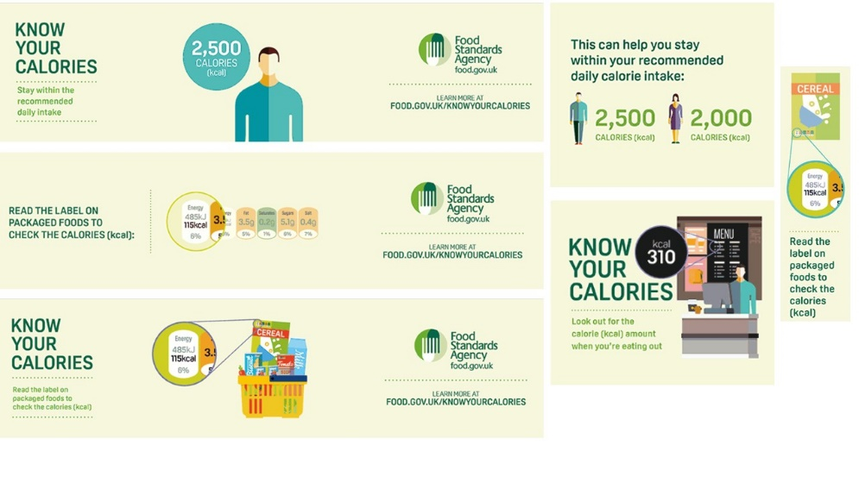
Awareness and recognition of the campaign remains comparable versus last wave
Spontaneous awareness of any communication about calories
Prompted recognition (image shown) of Know Your Calories
33% said the communications they saw were from the government
Top of mind recall of calorie communications
Respondent quotes
Weight and health concerns
“Link between waist size and increased cancer risk”
“On tv advertising the danger of high carbs and sugar and saturated fat, high cholesterol”
“Sugar, carbs and fatty foods causing type2 diabetes and heart disease.”
Reducing sugar
“How cereals may seem very healthy however contain lots of sugars”
“Reduced sugar in fizzy drinks”
Base too low to report source of awareness at W4 (n37)
Larger stim in appendix
Although the additional campaign burst will have helped with some awareness and recognition, increased spend will be needed to sustain or increase these levels
Source: 2CV Northern Ireland Tracking Project, Wave 4 May 2019.
CQ1: Have you seen or heard any communications about Calories recently (e.g. messages from companies on TV, posters, billboards, on social media or on the radio)? CQ3: Who do you think the communications were from? CQ4: Have you seen any of the following communications before today? Base: Nat Rep, W4 (312), Seen calorie communications (54)
Significant increase/ decrease versus previous wave

Slide 14
Key Take-outs: Wave 4, May 2019
1.
2.
3.
Building awareness
Awareness of calorie communications (both spontaneous and prompted) is stable versus previous waves and remains low overall
Recognition of the traffic light labelling remains strong and sees a directional increase in this wave
Building Understanding
Knowledge of the calorie RDA for men has significantly increased, but not for women
Understanding of what is ‘healthier’ reaches a new all time high
Awareness and understanding of traffic light labels continues to gradually increase
Changing behaviour
While likelihood of buying ‘healthier’ alternatives to regular products increases, this is not seen for lower calorie products
Use of traffic light labels is directionally up, and sugar remains the biggest concern for consumers using the traffic light images
Opportunity to increase importance of message for calories in traffic light labels or other comms
Continued campaign activity which is more targeted will be necessary in order to maintain or build on awareness and recall of the campaign
Men still are less likely to know their calorie RDA, so an opportunity to increase message targeting amongst men
Next Steps: Wave 5 to follow in November 2019

Slide 15
Appendix

Slide 16
Selection of campaign images

Slide 17
Thank you
emma.johns@2cv.com
lexi.keegan@2cv.com
Please click on this link to access our
Terms and Conditions

