Slide 1
ST-53
Breakdown of ST-21 clonal complex using SNP phylogeny
Blue IID1
Red IID2
ST-21
ST-262
ST-21 complex
ST-21
ST-520
ST-19
ST-50
ST-47
ST-206 / ST-48 complexes
ST-104
ST-21 complex
ST-48 complex

Slide 2
Breakdown of the ST-48 clonal complex using SNP phylogeny
ST-206 complex
ST-475
ST-48 complex
ST-206 complex
ST-21 complex (ST-104)
ST-205
ST-48 complex
ST-48
ST-38
ST-48 complex

Slide 3
ST-257
ST-2030
Breakdown of ST-257 clonal complex using SNP phylogeny
ST-257 complex
ST-257
ST-443 complex
ST-353 complex
ST-52 complex
ST-824
ST-257 complex
ST-460 complex
ST-354 complex

Slide 4
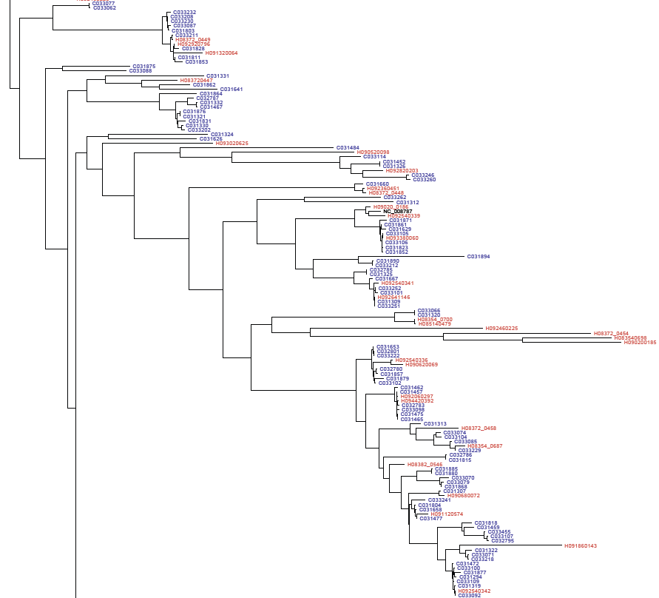
SNP phylogeny of other major clonal complexes
ST-48 complex
ST-61 complex
ST-49 complex
ST-433 complex
ST-42 complex
ST-22 complex
ST-508 complex
ST-45 complex

