Slide 1
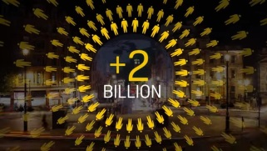
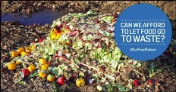
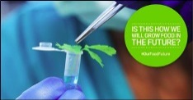
Oxford Business School project Research with Ladislav Miko, Head of EU Food Public engagement campaigns: - Food waste - Young people Future public dialogues (vulnerable groups)
Evidence
Consumer empowerment
Influence
……………………………………………………..
@BinnyGraham
More transparency in the food
chain will also help to build better
trust amongst customers
…….…….
@inductionJCT
#OurFoodFuture the research based
tagline #StopThinkChoose is great
and something we should
encourage people to do
……….…………………..
@amgallagh_UU
We’re not too small to make a difference …enjoy the summing
up of #OurFoodFuture
……………………………………….
…………………………………………………………….…..
……….…………………..
Platform and increased legitimacy in this space
Evidence for strategic discussions on
Regulating our future
Future policy development
Campaigns (assets: report, movie, soundbites
influencer factsheets, gifs and e-cards)
New reinvigorated relationships
Over 160,000
people
engaged
Over 6,000
watched live
Trended
for over
three hours
150 Industry
experts
Over 2,000
retweets
Reached an
estimated
15 million
…………..
……………………………………………………..

